Slide 1
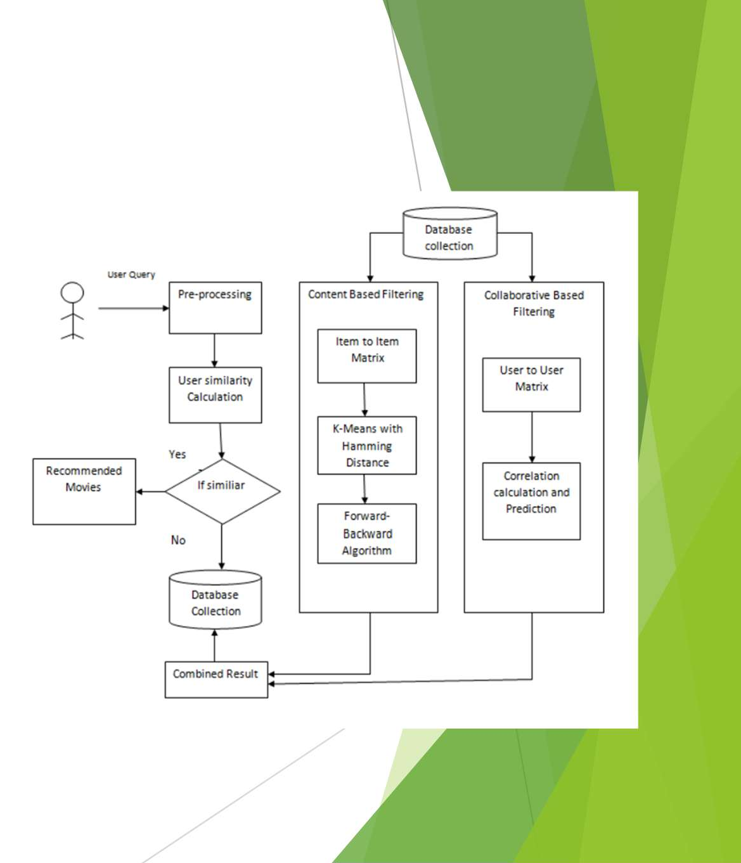

Introduction to Movie Recommendation & Review System
A Movie Recommendation & Review System helps users discover movies tailored to their preferences.
It also enables users to share and read reviews, enhancing the viewing experience.
These systems combine data analysis, user feedback, and machine learning techniques to improve accuracy and relevance.

Slide 2

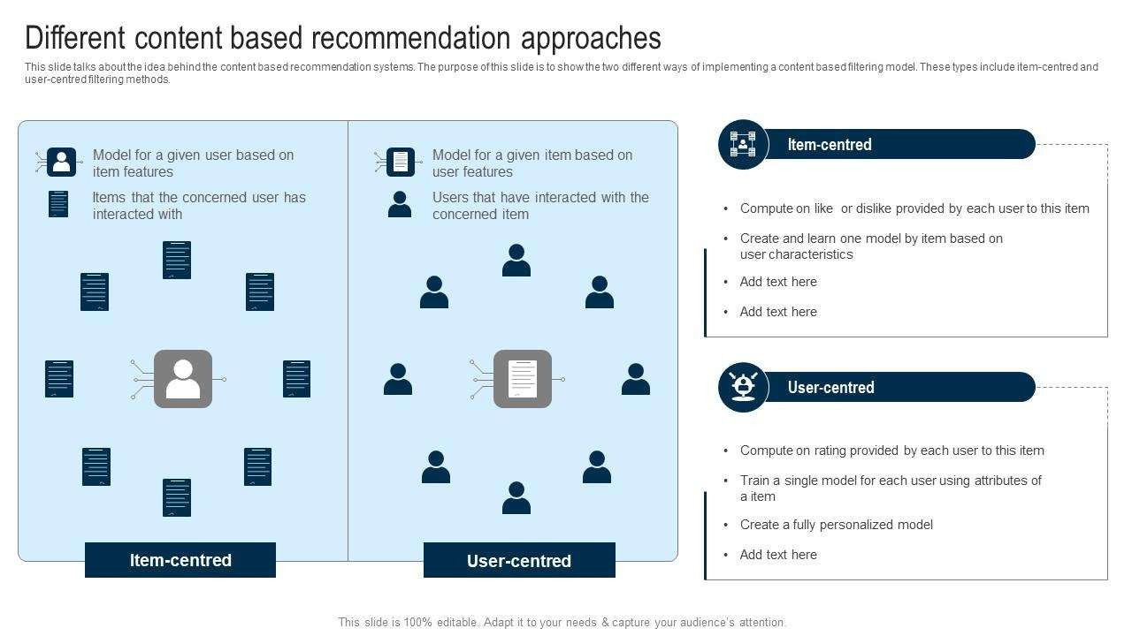
Types of Movie Recommendation Approaches
Collaborative filtering predicts user preferences based on similar users' behavior and ratings.
Content-based filtering recommends movies with similar attributes to those a user has liked previously.
Hybrid methods combine multiple techniques to overcome limitations and provide more accurate recommendations.

Slide 3
Data Sources for the System
User ratings, reviews, and viewing history form the core data for personalized recommendations.
Movie metadata such as genre, cast, director, and release year enrich the recommendation process.
External data like social media trends and critic reviews can also enhance system insights and relevance.

Slide 4
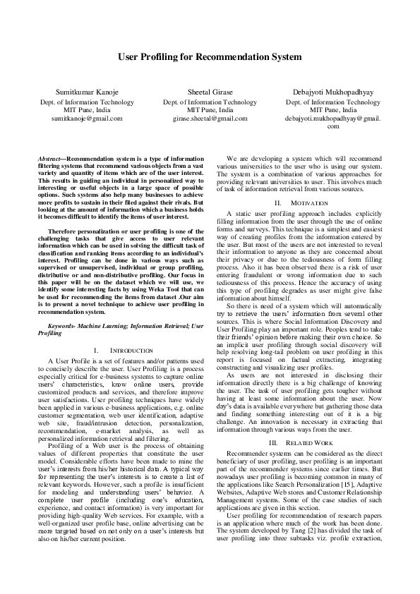
Key Components of the System
User profiling captures individual preferences and viewing habits to tailor recommendations.
Recommendation engine applies algorithms to generate personalized movie suggestions.
Review aggregation collects and analyzes user reviews to inform both recommendations and user trust.

Slide 5

Popular Algorithms Used
Matrix factorization techniques like Singular Value Decomposition (SVD) are widely used for collaborative filtering.
Content-based filtering employs vector similarity and keyword matching to find similar movies.
Machine learning models such as neural networks can integrate multiple data sources for improved predictions.

Slide 6
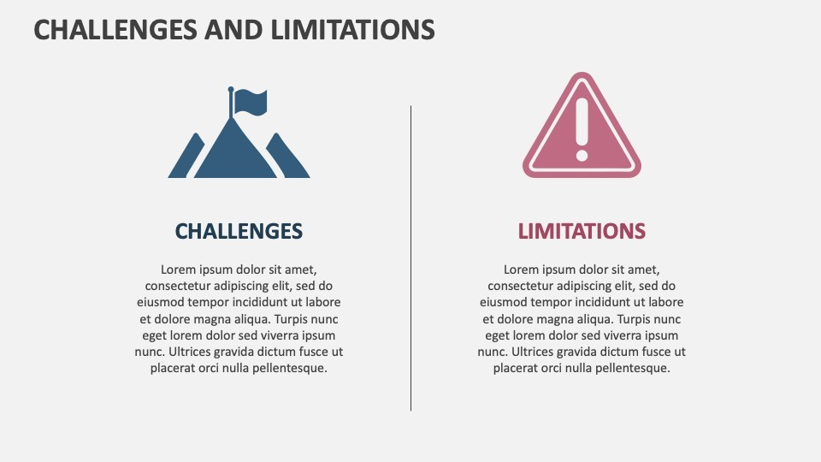
Challenges & Limitations
Cold-start problem occurs when new users or movies lack sufficient data for accurate recommendations.
Popularity bias can lead to over- recommendation of trending movies, reducing diversity.
Ensuring review authenticity and managing fake reviews remain ongoing challenges for system credibility.

Slide 7
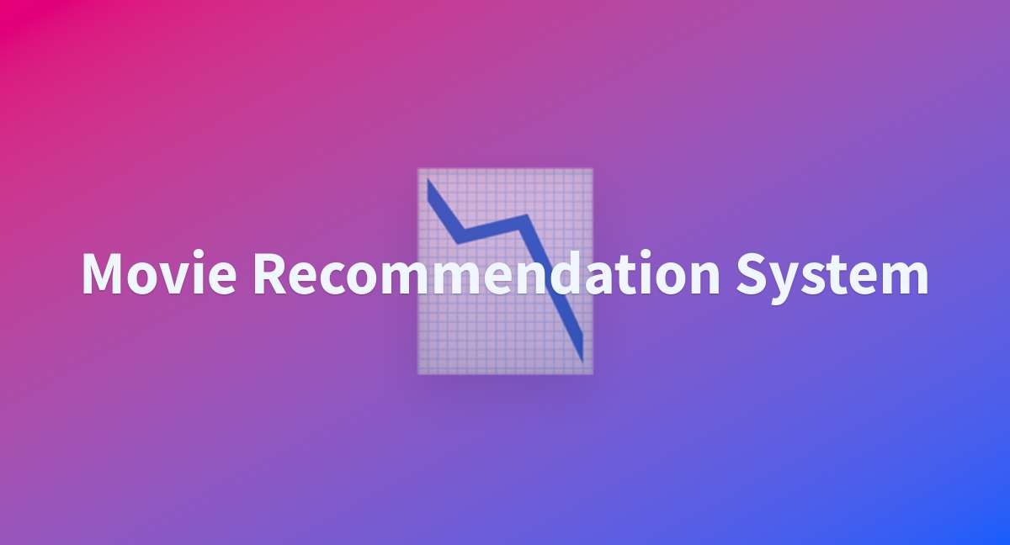
Future Trends & Conclusion
Incorporating advanced AI techniques like deep learning can enhance personalization and review analysis.
Real-time data processing and adaptive algorithms will make recommendations more dynamic and context-aware.
A well-designed Movie Recommendation & Review System can significantly improve user engagement and satisfaction in entertainment platforms.

Slide 8
THANK YOU

